Slide 1

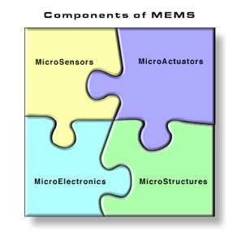
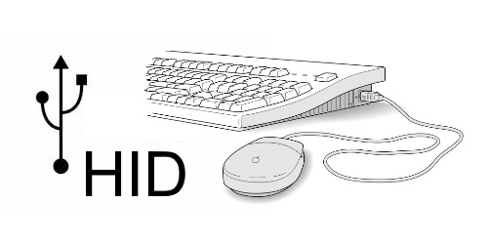
EC535 Final Project MEMs Mouse
Devin Kot-Thompson

Slide 2
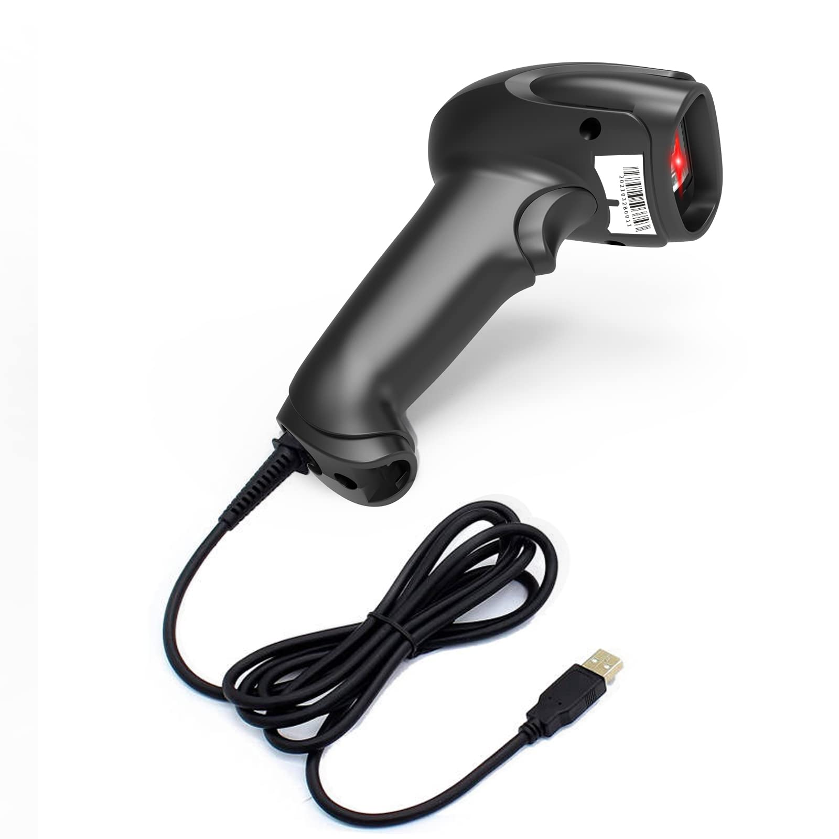
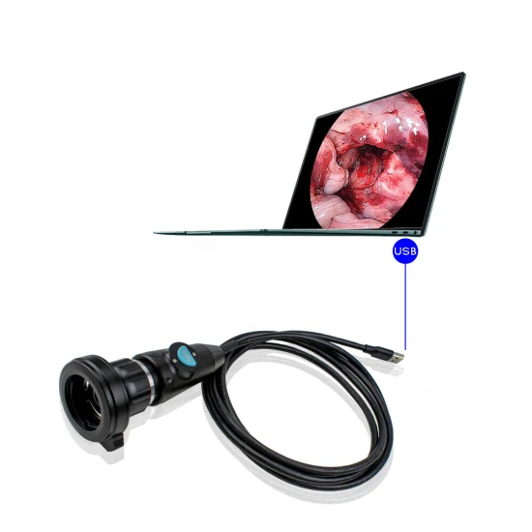
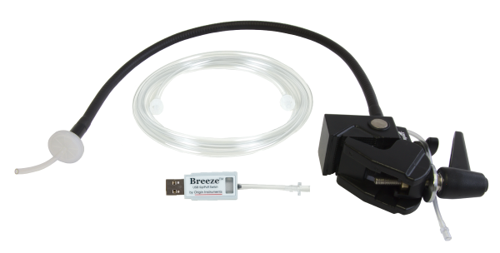
Overview
Development of a Custom USB HID device
MEMs Accelerometer X, Y, Z Input for Control of Host PC
Wrote SPI driver
Made Custom USB HID Report Descriptor
Motivation
Exploration of Custom Hardware for Device Interaction
Benefits Towards Individuals with Different Mobility Capabilities
USB HID Provides Driverless Protocol for Custom Hardware
Accessibility in Custom Hardware Development
Outcome
Mouse/Keyboard HID Device with Cursor Control Through Accelerometer X, Y Readings
Spacebar Interrupt Control Through Tap Detection by Custom in Hardware Accelerometer State Machine

Slide 3
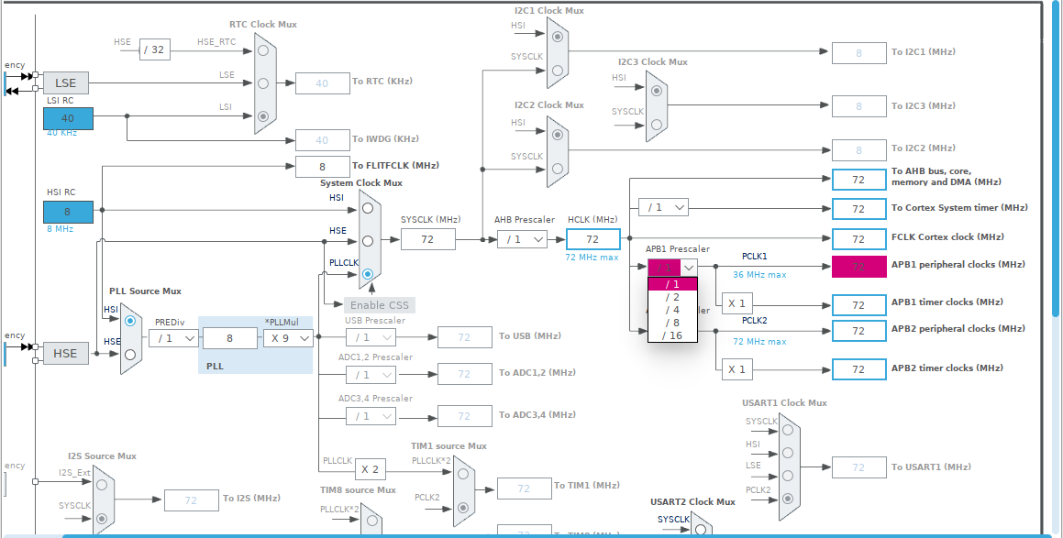
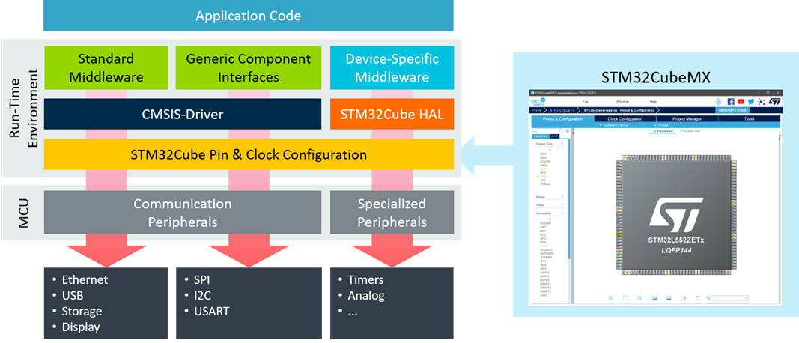
Methods
Tech Stack:
Hardware
STM32F407G-Disc 1 (ARM Cortex M4 w/integrated USB OTG)
LIS3DSH Accelerometer
Software
STM32CubeIDE
HAL (Hardware Abstraction Layer)
USB Device Middleware

Slide 4
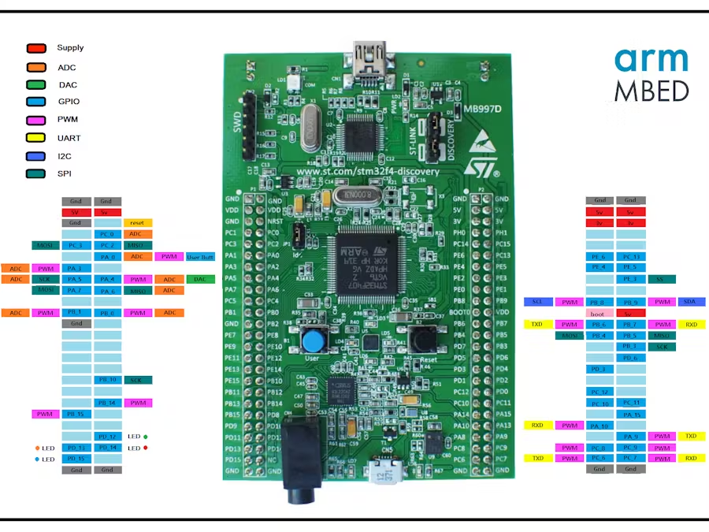
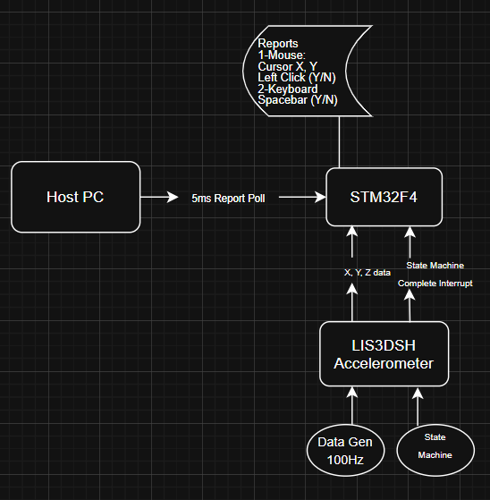
LIS3DSH Accelerometer

Slide 5
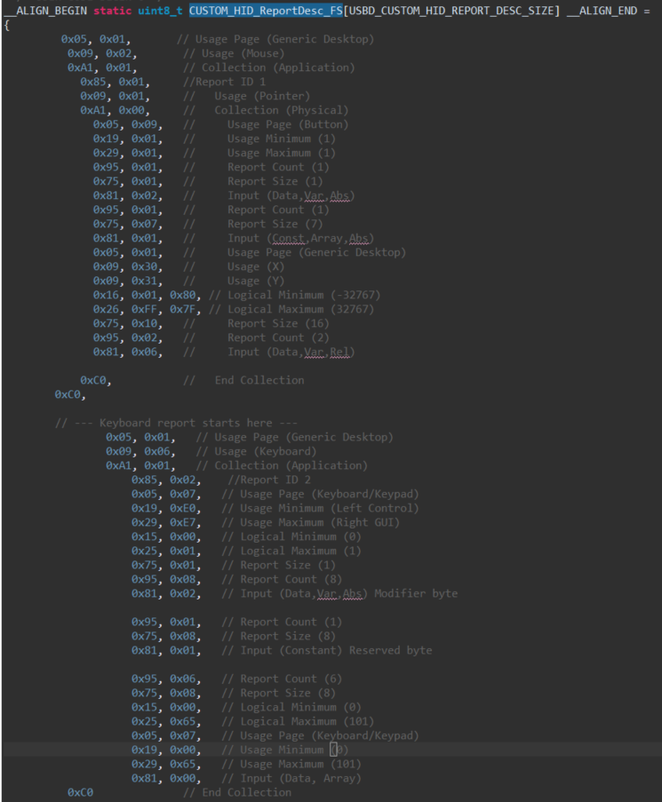
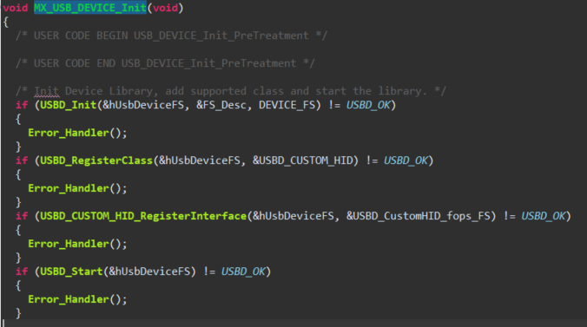
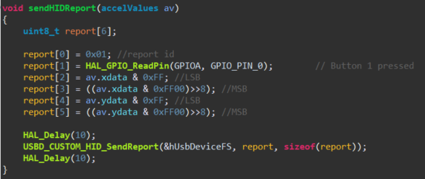
HID Report Descriptor
USB Enumeration
Sending Reports

Slide 6
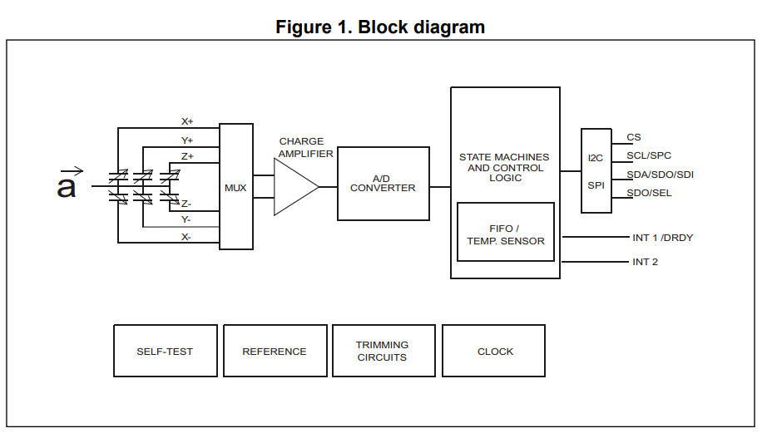
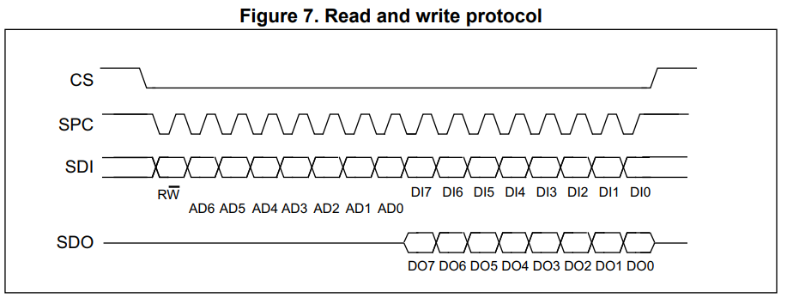
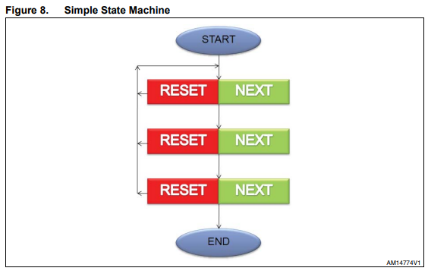
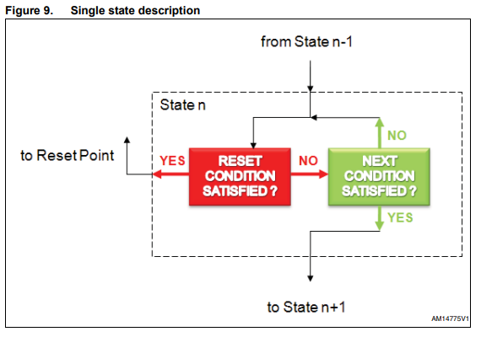
LIS3DSH Accelerometer & State Machines

Slide 7
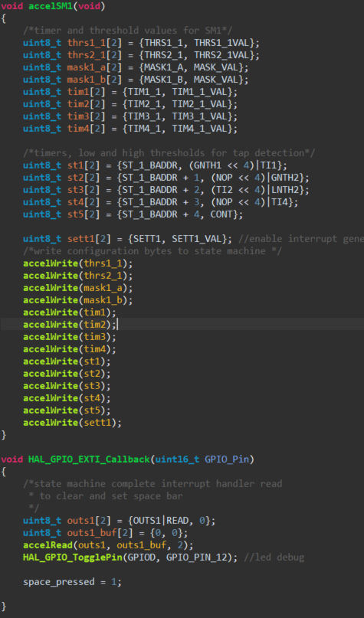
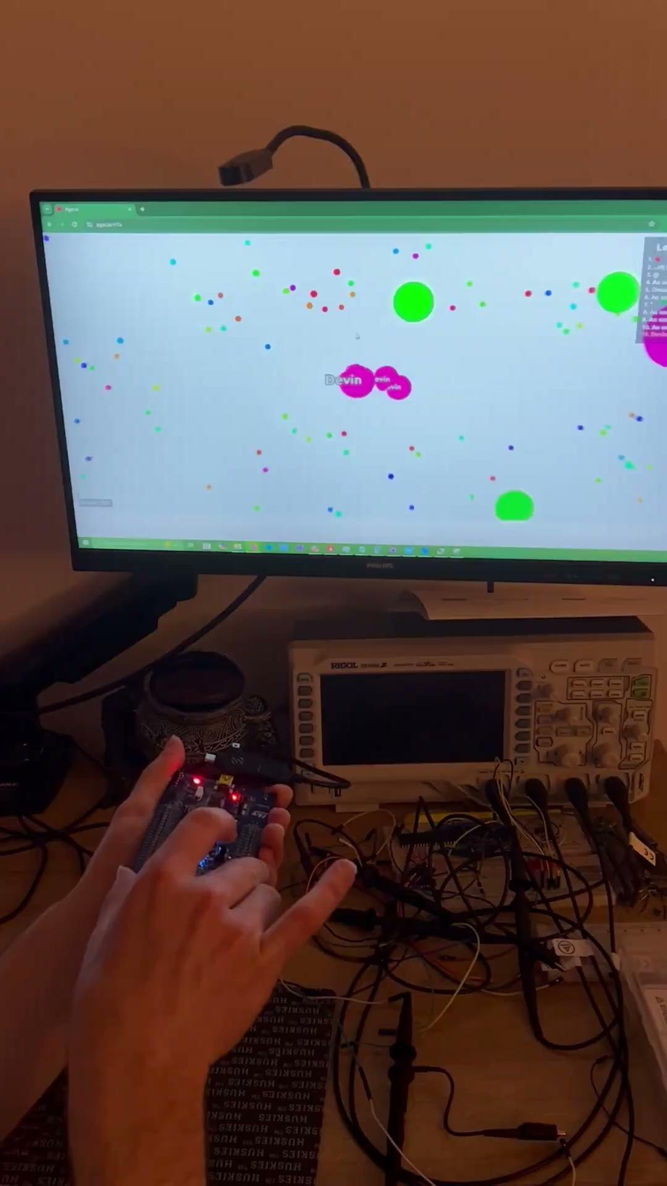
LIS3DSH Tap Detection State Machine and Interrupt
Results
X-Y axis tilt cursor control
Button Interrupt Left Click Control
Z-axis Single Tap Detection Interrupt for Space Bar Input w/Accelerometer and Hardware State Machines

Slide 8
Future Work
Implement More Gestures from LIS3DSH SM (Have up to 16 stages per SM and 2 SM)
Different Sensor Input (EMG)
Output Reports

Slide 9

Questions?

